Slide 1
NLM Indexing Initiative Tools for NLP:
MetaMap and the Medical Text Indexer
Natural Language Processing: State of the Art, Future Directions
April 23, 2012
Alan R. Aronson

Slide 2
Outline
Introduction
MetaMap
  Overview
  Linguistic roots
  Recent Word Sense Disambiguation (WSD) efforts
The NLM Medical Text Indexer (MTI)
  Overview
  MTI as First-line Indexer (MTIFL)
  Recent improvements
  Gene indexing

Slide 3
MetaMap/MTI Example
MetaMap identifies biomedical concepts in text
Medical Text Indexer (MTI) summarizes text using MetaMap and the
Medical Subject Headings
(MeSH) vocabulary

Slide 4
Outline
Introduction
MetaMap
  Overview
  Linguistic roots
  Recent Word Sense Disambiguation (WSD) efforts
The NLM Medical Text Indexer (MTI)
  Overview
  MTI as First-line Indexer (MTIFL)
  Recent improvements
  Gene indexing

Slide 5
MetaMap Overview
Named-entity recognition program
Identify UMLS Metathesaurus concepts in text
Linguistic rigor
Flexible partial matching
Emphasis on thoroughness rather than speed

Slide 6
The MetaMap Algorithm
Parsing
  Using SPECIALIST minimal commitment parser, SPECIALIST lexicon, MedPost part of speech tagger
Variant generation
  Using SPECIALIST lexicon, Lexical Variant Generation (LVG)
Candidate retrieval
  From the Metathesaurus
Candidate evaluation
Mapping construction

Slide 7
MetaMap Evaluation Function
Weighted average of
  centrality (is the head involved?)
  variation (average of all variation)
  coverage (how much of the text is matched?)
  cohesiveness (in how many pieces?)

Slide 8
MetaMap Processing Example
C0180860: Filters [mnob]
C0581406: Optical filter [medd]
C1522664: filter information process [inpr]
C1704449: Filter (function) [cnce]
C1704684: Filter Device Component [medd]
C1875155: Filter - medical device [medd]
Inferior vena caval stent filter (PMID 3490760)
Candidate Concepts:
909 C0080306: Inferior Vena Cava Filter [medd]
804 C0180860: Filter [mnob]
804 C0581406: Filter [medd]
804 C1522664: Filter [inpr]
804 C1704449: Filter [cnce]
804 C1704684: Filter [medd]
804 C1875155: FILTER [medd]
717 C0521360: Inferior vena caval [blor]
673 C0042460: Vena caval [bpoc]
637 C0038257: Stent [medd]
637 C1705817: Stent [medd]
637 C0447122: Vena [bpoc]
Metathesaurus String
UMLS Semantic Type
Metathesaurus Concept Unique Identifier (CUI)
MetaMap Score (≤ 1000)
C0038257: Stent, device [medd]
C1705817: Stent Device Component [medd]

Slide 9
MetaMap Final Mappings
Inferior vena caval stent filter
Final Mappings (subsets of candidate sets):
Meta Mapping (911)
909 C0080306: Inferior Vena Cava Filter [medd]
637 C1705817: Stent [medd]
Meta Mapping (911):
909 C0080306: Inferior Vena Cava Filter [medd]
637 C0038257: Stent [medd]

Slide 10
Word Sense Disambiguation (WSD)
Kids with colds may also have a sore throat, cough, headache, mild fever, fatigue, muscle aches, and loss of appetite.
Candidate MetaMap mappings for cold
  C0234192: Cold (Cold sensation)
  C0009264: Cold (Cold temperature)
  C0009443: Cold (Common cold)

Slide 11
Knowledge-based WSD
Compare UMLS candidate concept profile vectors to context of ambiguous word
Concept profile vectors’ words from definition, synonyms and related concepts
Candidate concept with highest similarity is predicted
Common cold |  |  | Cold temperature
Weight | Word |  | Weight | Word
265 | infect |  | 258 | temperature
126 | disease |  | 86 | hypothermia
41 | fever |  | 72 | effect
40 | cough |  | 48 | hot

Slide 12
Knowledge-based WSD
Kids with colds may also have a sore throat, cough, headache, mild fever, fatigue, muscle aches, and loss of appetite.
Common cold |  |  | Cold temperature
Weight | Word |  | Weight | Word
265 | infect |  | 258 | temperature
126 | disease |  | 86 | hypothermia
41 | fever |  | 72 | effect
40 | cough |  | 48 | hot

Slide 13
Automatically Extracted Corpus WSD
MEDLINE contains numerous examples of ambiguous words context, though not disambiguated
Candidate concept
Unambiguous synonyms
common cold
Query
CUI:C0009443
common cold
  "common cold"[tiab] OR
  "acute nasopharyngitis"[tiab] …
cold
PubMed
cold temperature
cold temperature
CUI:C0009264
"cold temperature"[tiab] OR "low temperature"[tiab] …

Slide 14
WSD Method Results
Corpus method has better accuracy than UMLS method
MSH WSD data set created using MeSH indexing
    203 ambiguous words
    81 semantic types
    37,888 ambiguity cases
Indirect evaluation with summarization and MTI correlates with direct evaluation
 | UMLS | Corpus
NLM WSD | 0.65 | 0.69
MSH WSD | 0.81 | 0.84

Slide 15
Outline
Introduction
MetaMap
  Overview
  Linguistic roots
  Recent Word Sense Disambiguation (WSD) efforts
The NLM Medical Text Indexer (MTI)
  Overview
  MTI as First-line Indexer (MTIFL)
  Recent improvements
  Gene indexing

Slide 16
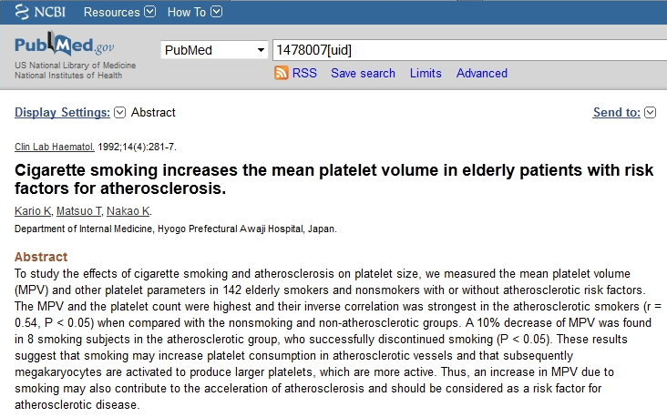
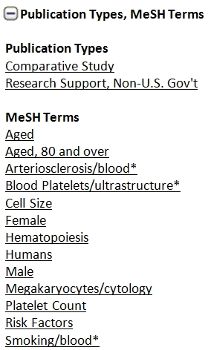
MEDLINE Citation Example

Slide 17
MTI
MetaMap Indexing – Actually found in text
Restrict to MeSH – Maps UMLS Concepts to MeSH
PubMed Related Citations – Not necessarily found in text
Received 2,330 Indexer Feedbacks
Incorporated 40% into MTI
March 20, 2012
Hibernation should only be indexed for animals, not for "stem cell hibernation"
Clove (spice) should not be mapped to the verb "cleave"

Slide 18
MTI Uses
Assisted indexing of MEDLINE by Index Section
Assisted indexing of Cataloging and History of Medicine Division records
Automatic indexing of NLM Gateway meeting abstracts
First-line indexing (MTIFL) since February 2011

Slide 19

MTI as First-Line Indexer (MTIFL)
Indexing Displays in PubMed as Usual
Indexing Displays in PubMed as Usual
MTI
Processes/
Recommends MeSH
Reviser
Reviews
Selects
Adjusts
Approves
MTI
Processes/
Recommends MeSH
Reviser
Reviews
Selects
Adjusts
Approves
Indexer
Reviews
Selects
“Normal”
MTI Processing
Indexer
Reviews
Selects

Slide 20
MTI as First-Line Indexer (MTIFL)
Indexing Displays in PubMed as Usual
Indexing Displays in PubMed as Usual
MTI
Processes/
Indexes MeSH
Reviser
Reviews
Selects
Adjusts
Approves
MTI
Processes/
Indexes MeSH
Reviser
Reviews
Selects
Adjusts
Approves
23 MEDLINE Journals
Index Section
Compares MTI and Reviser Indexing
45 MEDLINE Journals
MTIFL
MTI Processing
Indexer
Reviews
Selects
Notes:
Susan Roy – Library Associate Fellow

Slide 21
CheckTags Machine Learning Results
200k citations for training and 100k citations for testing
CheckTag | F₁ before ML | F₁ with ML | Improvement
Middle Aged | 1.01% | 59.50% | +58.49
Aged | 11.72% | 54.67% | +42.95
Child, Preschool | 6.11% | 45.40% | +39.29
Adult | 19.49% | 56.84% | +37.35
Male | 38.47% | 71.14% | +32.67
Aged, 80 and over | 1.50% | 30.89% | +29.39
Young Adult | 2.83% | 31.63% | +28.80
Female | 46.06% | 73.84% | +27.78
Adolescent | 24.75% | 42.36% | +17.61
Humans | 79.98% | 91.33% | +11.35
Infant | 34.39% | 44.69% | +10.30
Swine | 71.04% | 74.75% | +3.71

Slide 22
CheckTags Machine Learning Results
200k citations for training and 100k citations for testing
CheckTag | F₁ before ML | F₁ with ML | Improvement
Middle Aged | 1.01% | 59.50% | +58.49
Aged | 11.72% | 54.67% | +42.95
Child, Preschool | 6.11% | 45.40% | +39.29
Adult | 19.49% | 56.84% | +37.35
Male | 38.47% | 71.14% | +32.67
Aged, 80 and over | 1.50% | 30.89% | +29.39
Young Adult | 2.83% | 31.63% | +28.80
Female | 46.06% | 73.84% | +27.78
Adolescent | 24.75% | 42.36% | +17.61
Humans | 79.98% | 91.33% | +11.35
Infant | 34.39% | 44.69% | +10.30
Swine | 71.04% | 74.75% | +3.71

Slide 23
CheckTags Machine Learning Results
200k citations for training and 100k citations for testing
CheckTag | F₁ before ML | F₁ with ML | Improvement
Middle Aged | 1.01% | 59.50% | +58.49
Aged | 11.72% | 54.67% | +42.95
Child, Preschool | 6.11% | 45.40% | +39.29
Adult | 19.49% | 56.84% | +37.35
Male | 38.47% | 71.14% | +32.67
Aged, 80 and over | 1.50% | 30.89% | +29.39
Young Adult | 2.83% | 31.63% | +28.80
Female | 46.06% | 73.84% | +27.78
Adolescent | 24.75% | 42.36% | +17.61
Humans | 79.98% | 91.33% | +11.35
Infant | 34.39% | 44.69% | +10.30
Swine | 71.04% | 74.75% | +3.71

Slide 24
MTI - How are we doing?
Fruition of 2011 Changes
Focus on Precision versus Recall

Slide 25
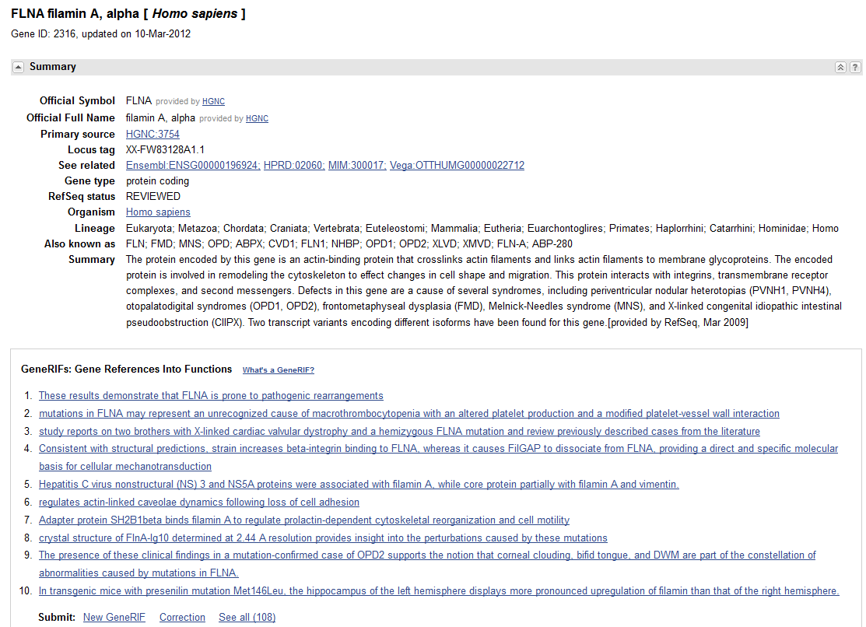

Slide 26
The Gene Indexing Assistant (GIA)
An automated tool to assist the indexer in identifying and creating GeneRIFs
  Evaluate the article
  Identify genes
  Make links to Entrez Gene
  Suggest geneRIF annotation
Anticipated Benefits:
  Increase in speed
  Increase in comprehensiveness

Slide 27
The NLM Indexing Initiative Team
Alan R. Aronson (Project Leader)
James G. Mork (Staff)
François-Michel Lang (Staff)
Willie J. Rogers (Staff)
Antonio J. Jimeno-Yepes (Postdoctoral Fellow)
J. Caitlin Sticco (Library Associate Fellow)
http://metamap.nlm.nih.gov

